Slide 1
Preventing Mother-to-Child Transmission of HIV
South to South Advanced Pediatric HIV Course
July 2015
Ola Adetokunboh MD MSc

Slide 2
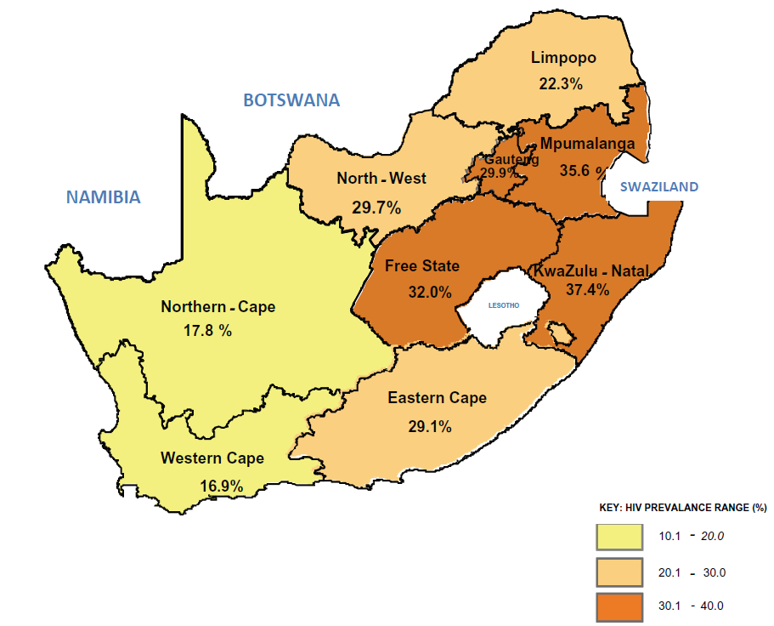
Epidemiology of HIV in South Africa
29.5%
2012 National Antenatal Sentinel HIV & Herpes Simplex Type-2 Prevalence Survey in South Africa
Paeds Course/PMTCT
Notes:
Without intervention a third of all unborn HIV Exposed babies at risk:
of contracting HIV
of being orphaned
79% tested for HIV
Of all women, 37% qual for HAART (CD4 <200) but were not on it
Main causes: TB, pneumonia, PJP, meningitis, GE

Slide 3
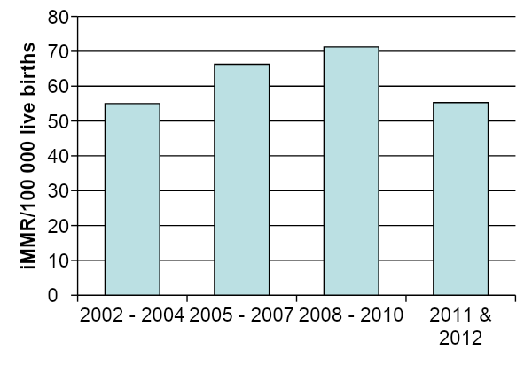
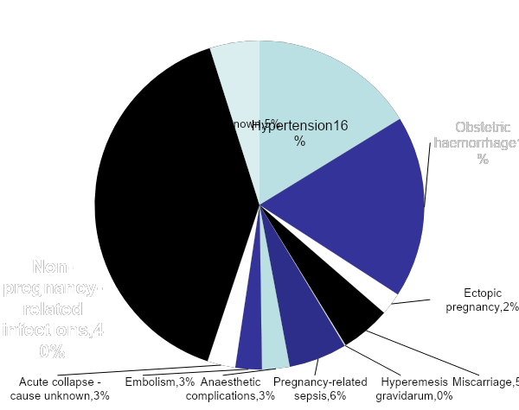
Maternal deaths
(Tenth interim report on Confidential Enquiries into Maternal Deaths in South Africa; 2011 & 2012; Pattinson R, Fawcus S and Moodley J for National Committee for Confidential Enquiries into Maternal Deaths
Paeds Course/PMTCT

Slide 4
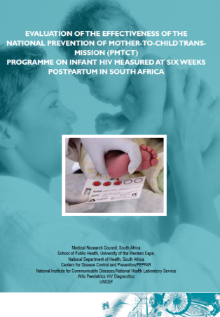
Mother-to-Child Transmission
3.5% MTCT at 6 weeks (range 1.4-5.9% across provinces)
4.1% infants of reported HIV- mothers had +HIV Ab
35.1% HIV+ mothers intended to obtain infant PCR test
Paeds Course/PMTCT
Notes:
Study done 2010
Reasons HIV Ab in reported HIV- mothers:
Mother not admit HIV status
Mothers tested in window period
Poor performance of rapid test (QC) – reported field sensitivity 87-95%
Acquisition after last HIV test

Slide 5
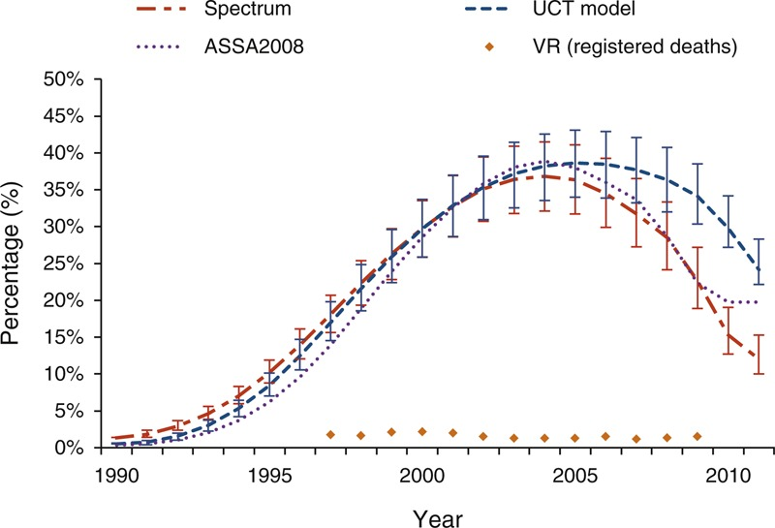
Infant and child deaths
Trend in percentage of under-5 deaths in SA due to AIDS
South African child deaths 1990 – 2011: have HIV services reversed the trend enough to meet Millenium Development Goal 4? Kerber KJ, Lawn JE, Johnson LF et al.
Notes:
Acc to stats SA 2007, 4% U5 deaths had HIV/AIDS as underlying cause
South African child deaths 1990 – 2011: have HIV services reversed the trend enough to meet Millenium Development Goal 4? Kerber KJ, Lawn JE, Johnson LF et al.

Slide 6
Learning objectives
Review factors that affect MTCT & transmission risk
Describe full package of care for the mother/infant pair to optimise HIV free survival and maternal health
Familiarize with PMTCT policy
Paeds Course/PMTCT

Slide 7
Understanding Transmission and Transmission Risk
When can HIV be transmitted to baby?
Paeds Course/PMTCT
Paeds Course/PMTCT

Slide 8
Mother-to-Child Transmission Process
Antenatal
Peripartum
Postnatal
Paeds Course/PMTCT
Notes:
Use every opportunity – transmission can occur at any stage
Also preconceptually
Remember from delivery you have 2 patients: a diad – closely linked; don’t forget mother’s health – screen for HIV in prev negative; screen for TB/ opp inf; ensure ART adherence & psychosocial support
Antenatal factors
High maternal VL
Placental abruption
STIs
Maternal malnutrition
Advanced HIV disease
Intra-uterine growth restriction (IUGR)
Peripartum factors
High maternal VL
ROM >4 hours before delivery
Invasive delivery procedures
First infant in multiple birth
Chorioamnionitis
STI’s during labour and delivery
Postnatal factors
High maternal VL
Duration of breastfeeding
Early mixed feeding
Breast abscesses, nipple fissures, mastitis
Poor maternal nutritional status
Oral disease in the baby

Slide 9
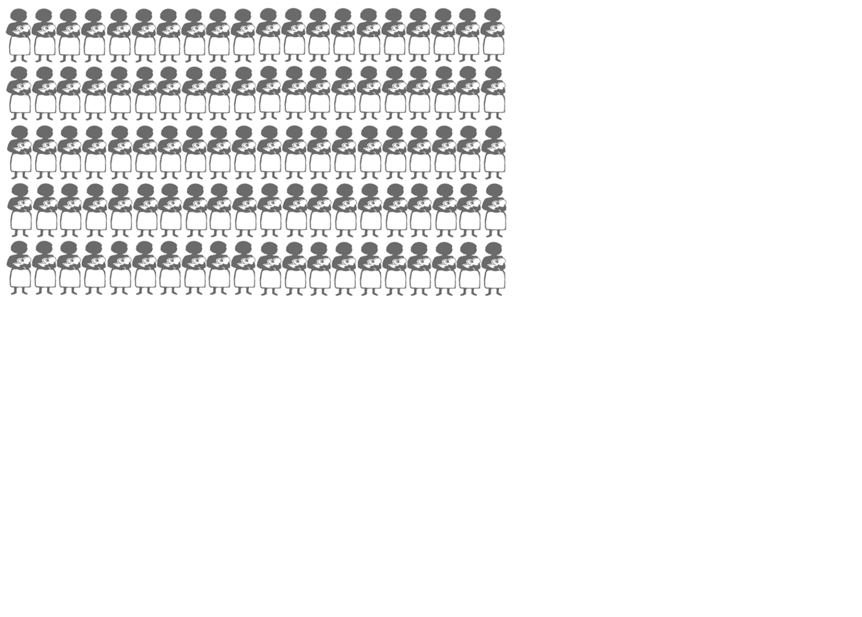
100 HIV-infected mothers
Modified from WHO, UNAIDS, UNICEF: HIV and Infant Feeding Counselling:
a training course. 2000
Notes:
Modified from WHO, UNAIDS, UNICEF: HIV and Infant Feeding Counselling: a training course. 2000

Slide 10

Without any treatment-10 will transmit HIV during pregnancy
Notes:
Range: ANC: 5-10

Slide 11
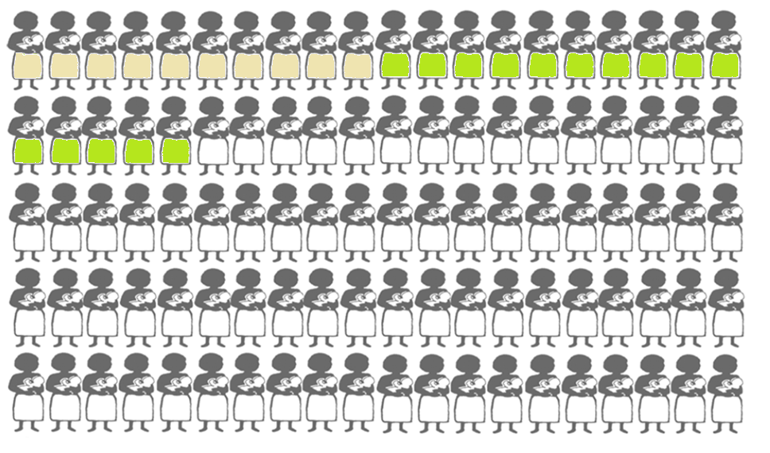
Without any treatment-15 will transmit HIV during labor & delivery
Notes:
Range: labour & deliv: 10-15 – not this is a short period of time with a higher risk than the whole of ANC

Slide 12
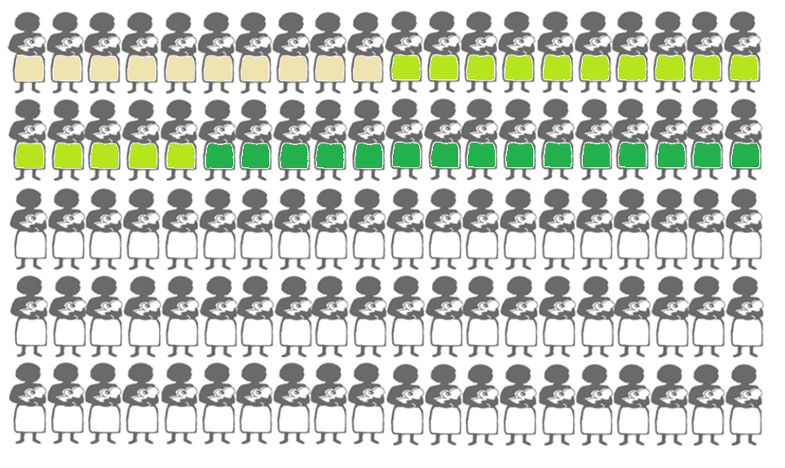
Without any treatment 15 will transmit HIV during breastfeeding
Notes:
Range: 5-20
~15 if not exclusive breastfeeding & breastfed for ~ 2years

Slide 13
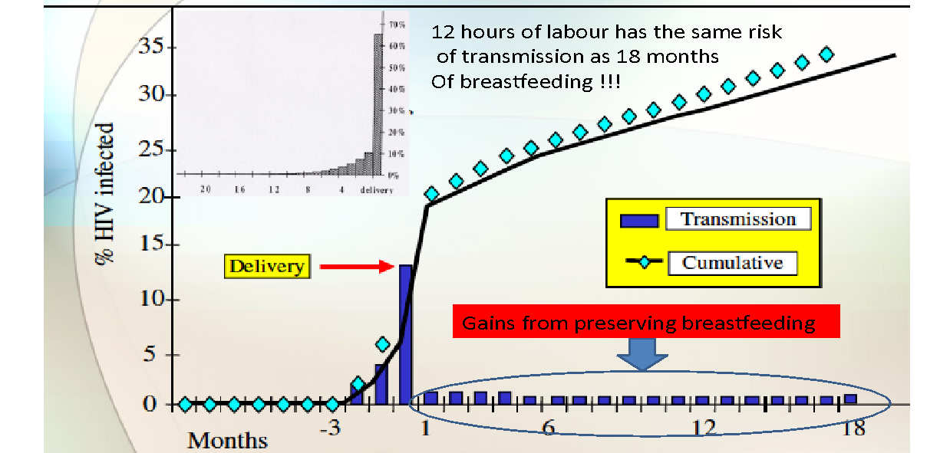
Risk of Breastfeeding Transmission
Paeds Course/PMTCT

Slide 14
What are the risk factors for MTCT
during pregnancy, labour & delivery and during breastfeeding?
Antenatal
Peripartum
Postnatal
Paeds Course/PMTCT
Notes:
Use every opportunity – transmission can occur at any stage
Also preconceptually
Remember from delivery you have 2 patients: a diad – closely linked; don’t forget mother’s health – screen for HIV in prev negative; screen for TB/ opp inf; ensure ART adherence & psychosocial support
Antenatal factors
High maternal VL
Placental abruption
STIs
Maternal malnutrition
Advanced HIV disease
Intra-uterine growth restriction (IUGR)
Peripartum factors
High maternal VL
ROM >4 hours before delivery
Invasive delivery procedures
First infant in multiple birth
Chorioamnionitis
STI’s during labour and delivery
Postnatal factors
High maternal VL
Duration of breastfeeding
Early mixed feeding
Breast abscesses, nipple fissures, mastitis
Poor maternal nutritional status
Oral disease in the baby

Slide 15
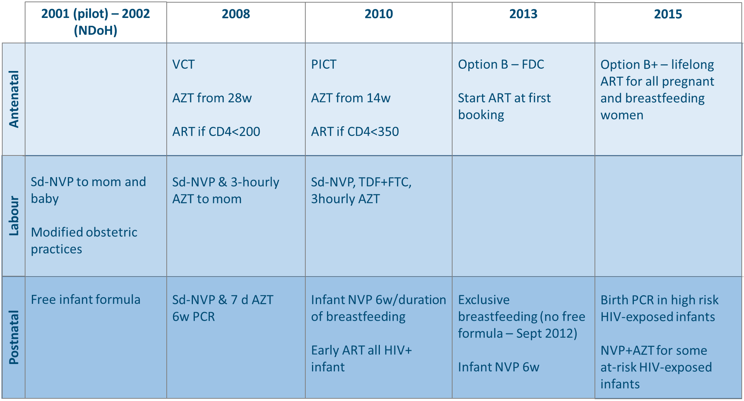
PMTCT Trends
Paeds Course/PMTCT

Slide 16
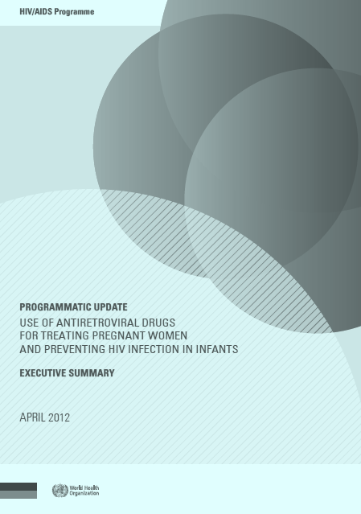
WHO programmatic update - 2012
Option A:
ANC: AZT from 14w
Intrapartum: AZT, sdNVP at birth
+ cover of NVP tail
Infant NVP 4-6w or cessation
breast-feeding if mom not on ART
Paeds Course/PMTCT

Slide 17
WHO programmatic update - 2012
Option B
ART from 14w until cessation of breast-feeding
Infant NVP 4-6w
Option B+
Lifelong ART
Infant NVP 4-6w
Paeds Course/PMTCT

Slide 18
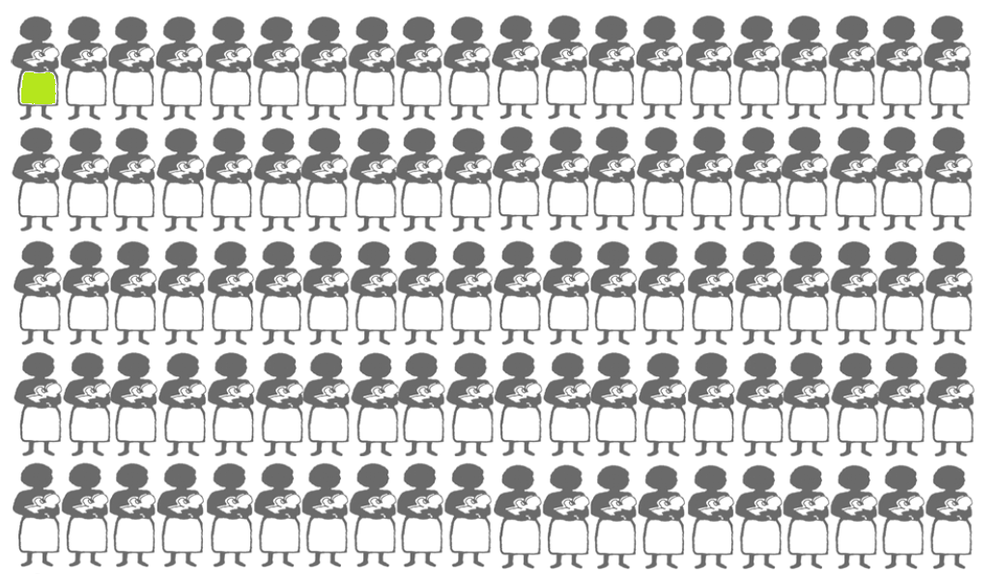
Antiretroviral treatment and the chance can be less than 1 child out of 100
Notes:
How can we make sure that adherence is good: antenatally; during labour & delivery; postnatally;

Slide 19
PMTCT risk
Regimen (mother) | Infant feeding | Transmission rate
HAART | Breast feeding | <1 % if VL suppressed
PMTCT - AZT | Breast feeding | AT BIRTH 2.2% AT 18 months -13.9%
Paeds Course/PMTCT

Slide 20

What is your end–in–mind for PMTCT programme?
Paeds Course/PMTCT

Slide 21
WHO Four Pronged PMTCT Strategy
Prevention of HIV in uninfected women, especially young women
Prevention of unintended pregnancies in HIV-infected women
Prevention of transmission from an HIV-infected woman to her infant
Care & support for mother and family
General Population
FP & Postnatal Clinics
HIV Care/
Treatment
ANC Clinics
Paeds Course/PMTCT
Notes:
Further, as many of you know, preventing unintended pregnancies is a cornerstone of the WHO/UN’s PMTCT Strategy, as you can see here. Traditionally, however, PMTCT programs focus mostly on Element 3, providing HIV prophylaxis to already pregnant HIV+ women.
Use this opportunity to clarify integration of FP and HIV for PMTCT generally, and FP specifically into PMTCT services.
Yet, there are several opportunities for integration across the four prongs

Slide 22
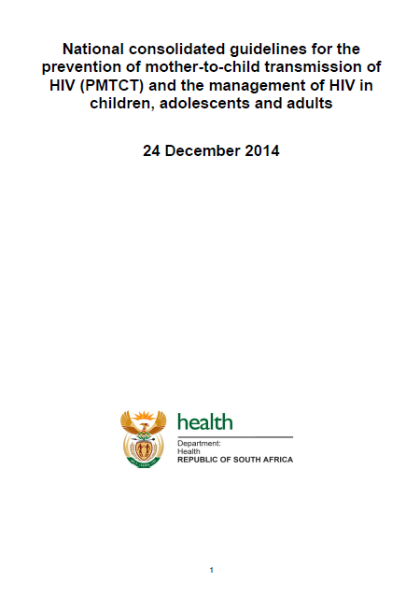

Homework
Paeds Course/PMTCT

Slide 23
Option B versus Option B+
Paeds Course/PMTCT

Slide 24
Rationale: Shift from Option A to B+ or B
BENEFITS FOR MOTHER AND CHILD | BENEFITS FOR PROGRAM DELIVERY & PUBLIC HEALTH
Ensures all ART eligible women initiate treatment | Reduction in number of steps along PMTCT cascade
Prevents MTCT in future pregnancies | Same regimen for all adults (including pregnant women)
Potential health benefits of early ART for non-eligible women | Simplification of services for all adults
Reduces potential risks from treatment interruption | Simplification of messaging
Improves adherence with once daily, single pill regimen | Protects against transmission in discordant couples
Reduces sexual transmission of HIV | Cost effective
Notes:
Benefits of single, standardized regimen for PMTCT and Rx HIV+ women
no drug changes across continuum of care
Simpler SCM
AZT monotherapy potential for developing TAMs
No longer dependent on CD4 result for initiation (initiation same day)
Improved linkages with ART programmes
Duration of infant NVP prophylaxis in breast-feeding shorter
(B) 2x more expensive than (A)
(B) & (A) were judged to be equally efficacious if implemented appropriately in women with CD4>350 (WHO 2012)
Option B: Adherence likely better with short-course than lifelong, Cheaper but ?less cost-effective in medium term BUT, ? Risk of NNRTI resistance, Treatment interruptions may be harmful
Option B+: Further programmatic simplification: ‘ART for Life’ , Risk transmission lowest in women on ART before conception, Late bookings covered if on ART from previous pregnancy, Earlier ART initiation may improve outcomes for mothers (WHO now CD4<500), Reduce horizontal transmission to HIV- partners, ? Cost-effectiveness of treatment scale-up BUT Ethics of (B+), Adherence, resistance, side-effects of long-term treatment, retention-in-care, Impact on the health system

Slide 25
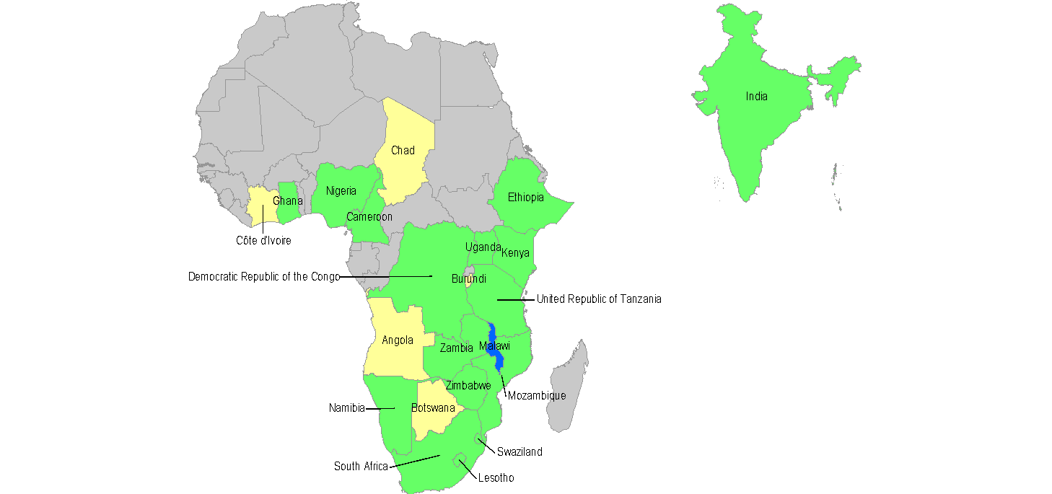
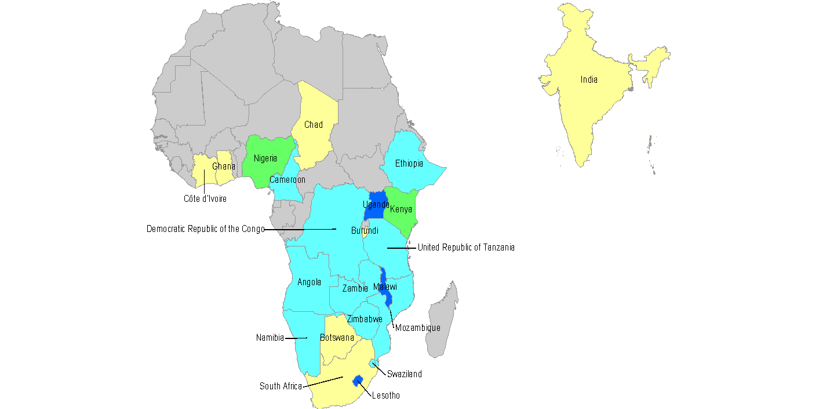
Rapid Change Towards B/B+
Transition in PMTCT Regimens in the 22 Global Plan Priority Countries
After 2010 WHO PMTCT ARV guidelines
As of June 2013
Paeds Course/PMTCT

Slide 26
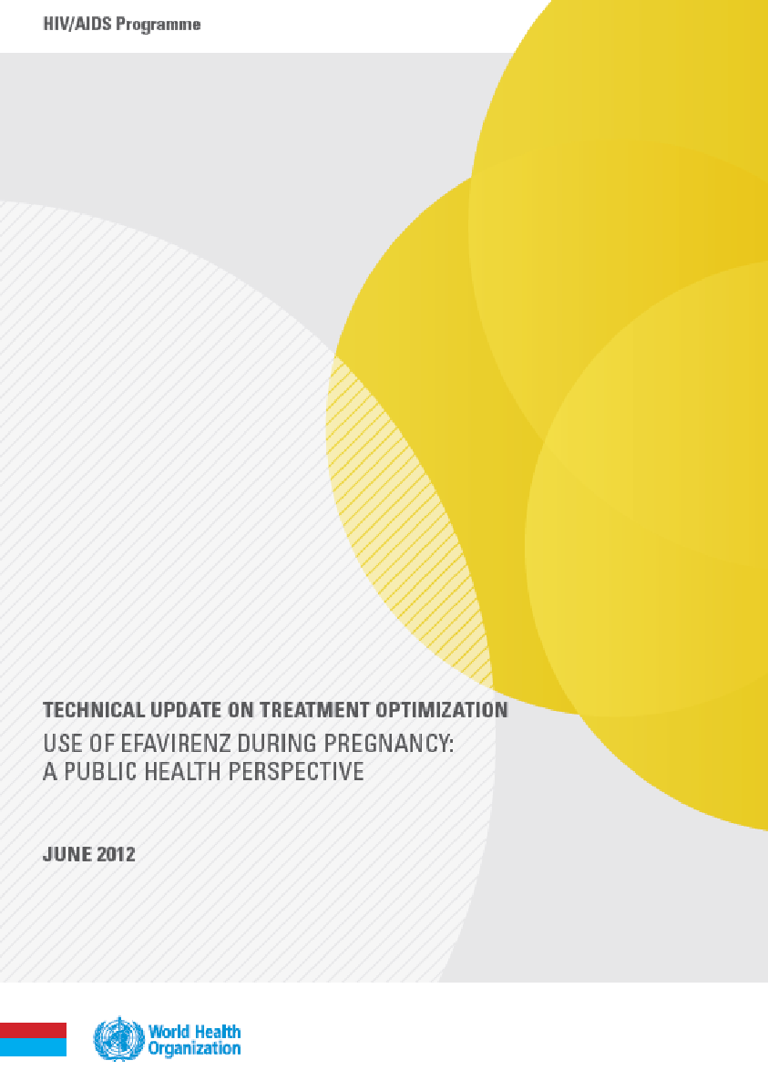
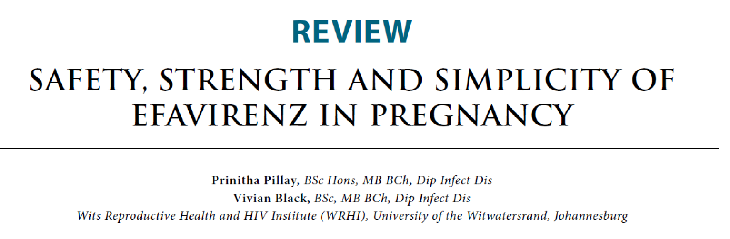
Is EFV safe in Pregnancy?
Rate of birth defects similar to that of other ARVs & similar to general population
Ongoing pharmaco-vigilance required
EFV is programmatically a better option
Notes:
Overall rate of birth defects reported in association with EFV similar to that reported for many other widely-used ARVs, and is consistent with rates of birth defects for the general population; Risk with EFV of congenital defects: 2.7%
NVP: 2.5%
AZT: 3.3%
A significant increase in the risk of neural tube defects has not been demonstrated;
Pharmacovigilance is required to accumulate information on drug safety;
Evidence also shows that EFV is more efficacious and better tolerated than NVP;
Still FDA class D: There is positive evidence of human fetal risk based on adverse reaction data from investigational or marketing experience or studies in humans, but potential benefits may warrant use of the drug in pregnant women despite potential risks.
EFV in pregnancy is programmatically easier to implement because drug substitution is no longer required during pregnancy and in patients with TB co-infection;

Slide 27
Antenatal Clinic
NO TURN AWAYS
Paeds Course/PMTCT

Slide 28
HIV testing: Mother
Don’t forget the patient’s world
The test must have a purpose:
HIV pos 🡪 access treatment
HIV neg 🡪 help client stay HIV neg
Use retesting opportunities:
ANC, peri-partum, postnatal
Every 3 months
Paeds Course/PMTCT
Notes:
Patient’s world:
Heard of patient that tested positive at first visit, started on ART & defaulted till 3rd trimester because was in shock/denial
Testing of Partner & family
Psychosocial support system
Are there systems that need to be put in place to make sure we are not missing opportunities for testing & harnessing patient’s support network (Note: back page of ART case record)
What systems do we need to put in place to remember to retest the mother during pregnancy & breastfeeding?
Retesting in ANC
6w baby visit
? Link w FP visits

Slide 29
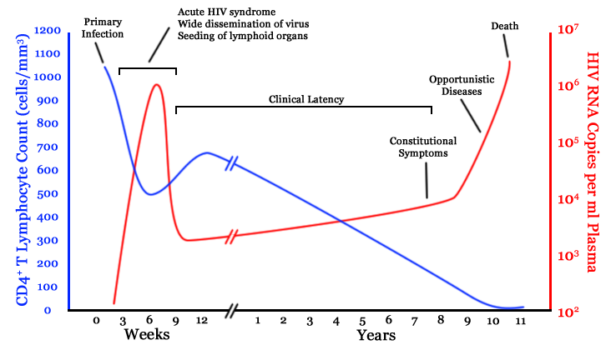
HIV testing: Mother
Paeds Course/PMTCT
Notes:
Patient’s world:
Heard of patient that tested positive at first visit, started on ART & defaulted till 3rd trimester because was in shock/denial
Testing of Partner & family
Psychosocial support system
Are there systems that need to be put in place to make sure we are not missing opportunities for testing & harnessing patient’s support network (Note: back page of ART case record)
What systems do we need to put in place to remember to retest the mother during pregnancy & breastfeeding?
Retesting in ANC
6w baby visit
? Link w FP visits

Slide 30
Maternal ART eligibility
Pregnant
Breastfeeding
Within 1 year postpartum regardless of feeding practice
HIV positive partner of sero-discordant couple
Paeds Course/PMTCT
Notes:
Also include those who had miscarriage/ TOP
Messaging for Lifelong ART for pregnant & BF women
Women who start lifelong ART earlier will live longer and healthier lives
A woman who takes her lifelong ART as prescribed gives her baby the best chance of being HIV-free
By taking lifelong ART, a woman is protecting future babies from getting HIV as well as partners who are HIV uninfected

Slide 31
Variation on ART Regimens
Unable to start TFE-FDC on same day, start AZT
Eligible for lifelong ART but can’t use TFE-FDC
Renal disease: ABC+3TC+EFV
Psychiatric: TDF+FTC+(NVP or LPV/r)
Paeds Course/PMTCT
Notes:
Unable to start HAART same day includes: known renal or psychiatric disease where consultation/CD4 results necessary or TB v likely

Slide 32


Monitoring during pregnancy and breastfeeding
VIRAL LOAD
VIRAL LOAD
VIRAL LOAD
Paeds Course/PMTCT
Notes:
Go over monitoring worksheet

Slide 33
Responding to VL results
<50 copies/ml 🡪
continue routine monitoring according to schedule
400 – 1000 copies/ml 🡪
adherence support;
continue VL monitoring according to routine monitoring schedule or sooner if worried about adherence
>1000 copies/ml 🡪
repeat VL 1/12
🡪VL undetectable or ≥1 log drop 🡪 continue VL monitoring according to routine monitoring schedule
🡪VL increased or same or <1 log drop 🡪 2nd line ART + birth PCR + infant prophylaxis (AZT+NVP)
Notes:
Note diffs with non-preg adult monitoring - >1000 repeat in 2/12

Slide 34
Explaining the log drop
Log values make it easier to deal with big numbers
Log₁₀ shows a number as a factor of 10
A 1 log drop in VL means that the VL has dropped 10-fold:
From 500 000 to 50 000 = 1 log drop
From 5000 to 500 = 1 log drop

Slide 35
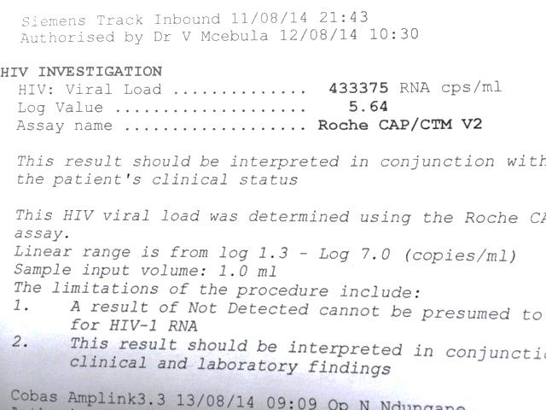
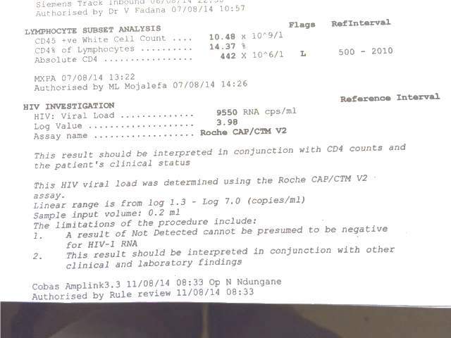
Explaining the log drop (1)
Viral Load 1
Viral Load 2

Slide 36
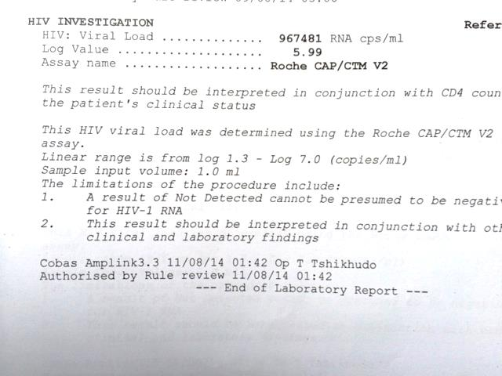
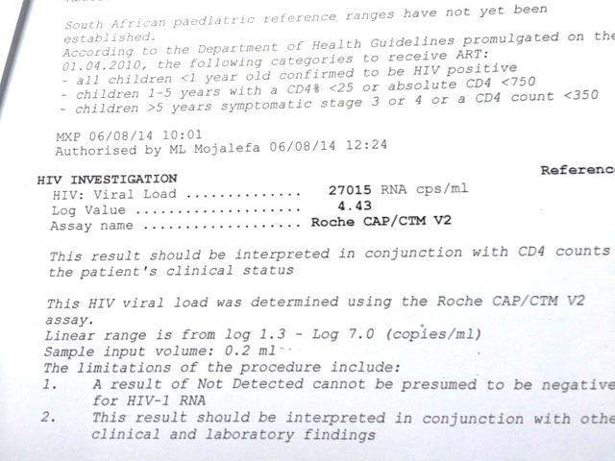
Explaining the log drop (2)
Viral Load 1
Viral Load 2

Slide 37
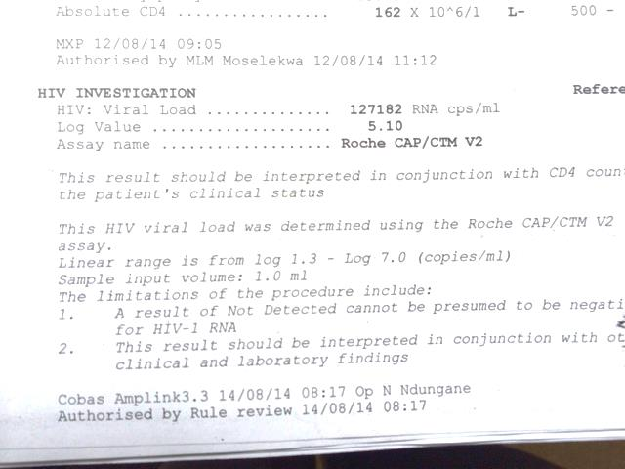
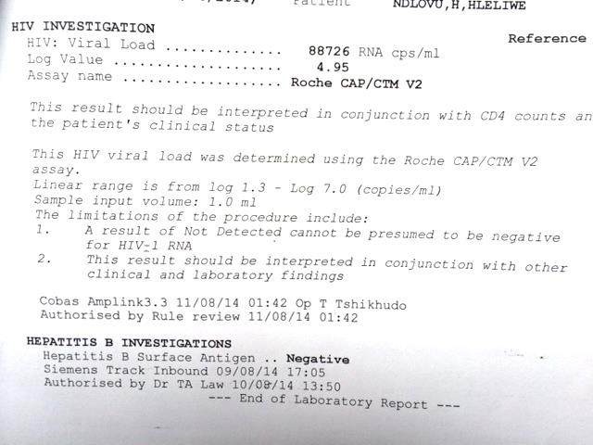
Explaining the log drop (3)
Viral Load 1
Viral Load 2

Slide 38
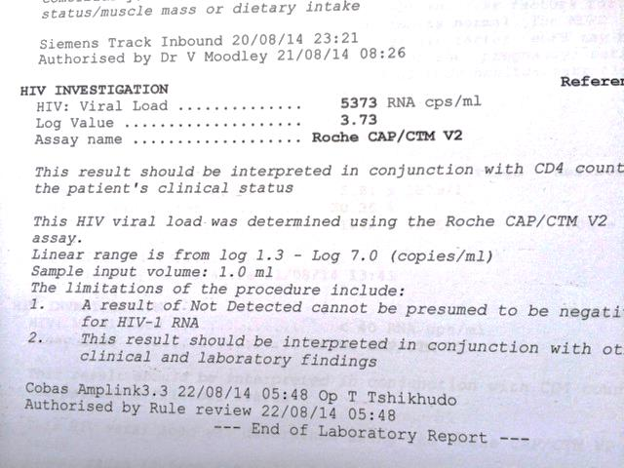
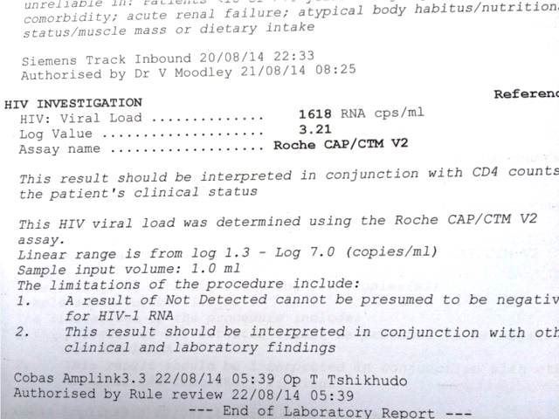
Explaining the log drop (4)
Viral Load 1
Viral Load 2

Slide 39

Labour and Delivery
Paeds Course/PMTCT

Slide 40
Labour and Delivery
On ART 🡪
Unbooked or newly diagnosed in labour 🡪
Defaulted ART 🡪
Note: birth PCR & extended prophylaxis for infant
Notes:
Remember risk during labour & delivery… short time period, high risk 🡪 need to cover

Slide 41
Other diseases and interventions
TB & IPT
CPT
Cryptococcal disease in pregnancy
Paeds Course/PMTCT
Notes:
IPT duration in pregnancy: 12 months if neg/not available; vs non-preg – adults not on ART – neg – no IPT; on ART TST not avail – 6 months IPT
CPT: CPT safe in pregnancy 🡪 start if CD4<200 or stage 3/4 disease
Cryptococcal disease in preg: fluconazole teratogenic FDA class D (positive evidence of human fetal risk based on human data but the potential benefits from use of the drug in pregnant women with serious or life-threatening conditions may be acceptable despite its risks) – use only if benefits outweigh risk in T1: CLAT positive in preg discuss with ID expert; symptomatic 🡪 needs Rx; asymptomatic ART & wait til T2 to initiate ART;
ampho B class B (Animal studies have failed to reveal evidence of fetal harm. There are no controlled data in human pregnancy. Amphotericin B should only be given during pregnancy when benefit outweighs risk.)

Slide 42
The Newborn
Prophylaxis & Testing
Paeds Course/PMTCT

Slide 43

When can the mother hold a
because her baby is HIV negative?
Paeds Course/PMTCT

Slide 44
Infant testing
Exposed:
Any child born to an HIV-infected mother until a final status is determined.
Infected:
We know the child has the virus in their body
Uninfected:
We know the child is free of the virus and is no longer exposed or in a window period.
Paeds Course/PMTCT

Slide 45
Window Period
The time when someone can test negative but still be infected with the HIV virus.
Determined based on EXPOSURE to the virus:
For adults, the window period is based on SEX.
For young children it is BREASTFEEDING.
Paeds Course/PMTCT
Notes:
The window period is clearly defined as 6 weeks in the 2008 PMTCT and Paediatric HIV Care and Treatment Guidelines by MoH.

Slide 46
Availability Laboratory Tests(assays)
Immune Response | Virus directly
Rapid Tests | DNA HIV PCR Qualitative
HIV ELISA | RNA HIV PCR Quantitative - VL
Paeds Course/PMTCT
Notes:
DNA PCR
Detects the presence of the virus
Only use for diagnosis
Qualitative
RNA PCR
Quantitative – Viral load
Determines the quantity of viral copies/ml
Use for monitoring treatment response
(Can be used as a diagnostic test)
HIV 1/2
Antibody tests
relatively easy to perform
most widely used serological technique used.
Detect antibodies against HIV antigen (both IgM and IgG). HIV 1 & 2
Sensitivity >99% and specificity > 98%.
control to validate the result.
If used correctly, sensitivity and specificity approaching that of laboratory ELISA tests.
The Western blot test
A positive blot requires the presence of any two of the p24, gp41 and gp120/160 bands. Intermediate results are common (up to 20% of uninfected persons).
Virologic tests are expensive and involve complex laboratory methods. Contamination may be an issue.
DNA PCR assays amplify the HIV pro-viral DNA sequences within mononuclear cells present in peripheral blood.
‘Primers’, short sequences of synthetic DNA complementary to one end of a gene sequence of interest, target a specific DNA sequence of the HIV genome.
These primers then prime a DNA polymerase enzyme to make copies of the DNA to which they are bound. Different steps in the reaction results in an exponential increase in copies of the targeted DNA fragment.
The sensitivity of the DNA PCR is low during the first 1 or 2 weeks after birth as the test does not detect very low levels of HIV DNA. The sensitivity and specificity approaches 100% after 4-6 weeks of life.
HIV RNA assays detect viral RNA in plasma and other body fluids using either reverse transcriptase PCR, in vitro signal amplification nucleic acid probes (branched chain DNA), or nucleic acid sequence based amplification (NASBA). More sensitive for early detection of HIV infection.

Slide 47
Persistence of maternal antibodies in infants by Age
birth
9 months
18 months
Paeds Course/PMTCT
Notes:
We will repeat this later

Slide 48
Infant testing schedule
Paeds Course/PMTCT
Paeds Course/PMTCT

Slide 49
Infant HIV prophylaxis
Paeds Course/PMTCT

Slide 50
Summary: what is new?
Mom | - Lifelong regardless of CD4 - VL testing - HCT in labour ward - CD4< 100 🡪 CrAg test
Baby | - Prophylaxis: some get AZT + NVP; some get 12w NVP - Birth PCR
Other | - Think mother-baby pair - HIV+ partner in serodiscordant couple eligible
Paeds Course/PMTCT

Slide 51
Key messages
Early booking is key
Know the viral load and act!
Breast is best but VL needs to be LDL
Stay on ART for life to protect mum, baby and partner!
Paeds Course/PMTCT

Slide 52
Acknowledgment
Dr. Gina Bernhardt

